Slide 1
Control & Sensing of a Solar House

Slide 2
Introduction
Background and Motivation
Dynamic model
Control Design & Analysis
Controller Setup
Experimental Setup
Conclusion

Slide 3
Background and Motivation
Cooling and heating
Significant part of energy consumption
Reduce the usage of fossil fuels
Reduce their usags in buildings
Solar House

Slide 4
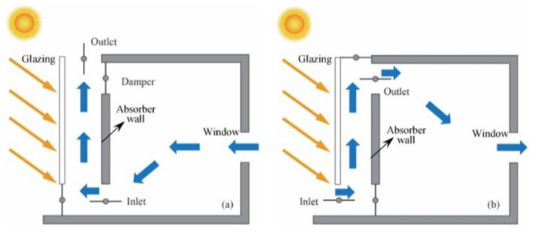
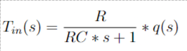
Dynamic Model
Based on thermal system
Transfer function developed based on thermal resistance and thermal capacity
R- radiation, convection, conduction
C-capacitance of house

Slide 5
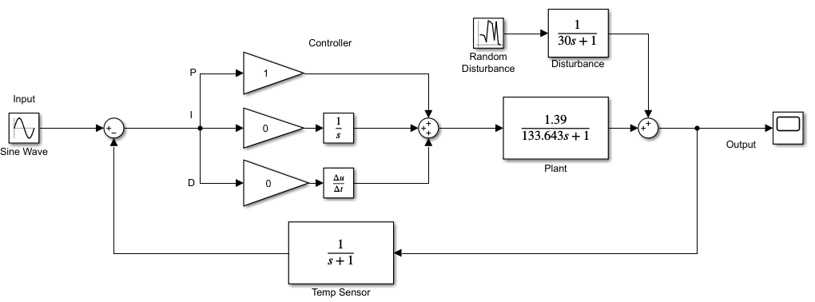
Controller Design

Slide 6
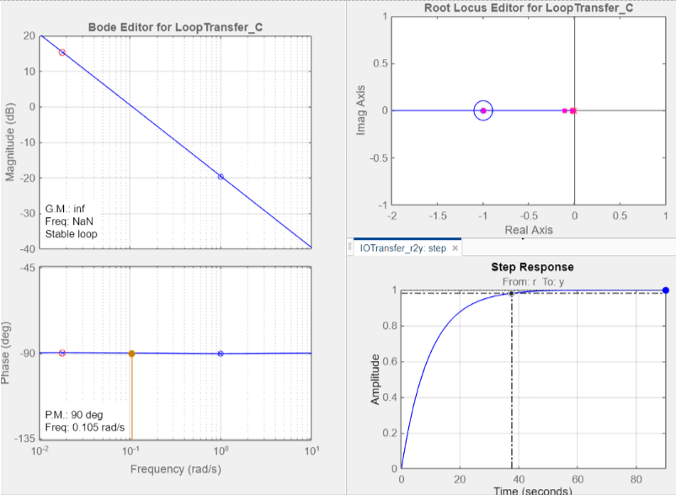
Controller Design
Relevant controller
could be either P or PI
Kp=10.04 , Ki=0.1794

Slide 7
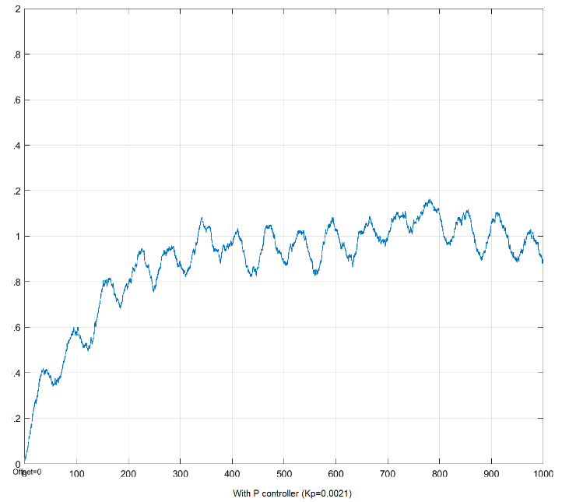
Controller DesigNn
When system is on/off mode with sin wave.

Slide 8
Controller Setup
- PID Controller
- Feedback system
- Control
- Final schematic
- Arduino code

Slide 9
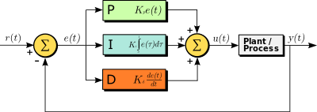
PID Controller
Notes:
proportional–integral–derivative controller
PID control uses closed-loop control feedback to keep the actual output from a process as close to the target or setpoint output as possible
It is based on the control of the input (voltage) in order to manipulate output (temperature)
After initial heating, temperature is observed and at the instant the temperature rises higher than the setpoint temperature, controller will lower input voltage with the aim of lower temperature.
The derivative part will react to the speed of temperature change - The more rapid the change, the greater the controlling or damping effect
I (integral) which accounts for past values of the errors and integrates them over time

Slide 10
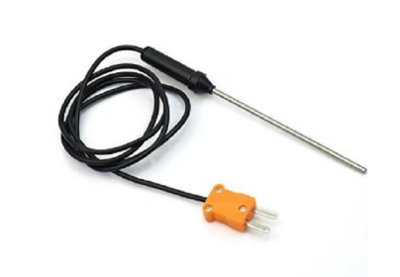
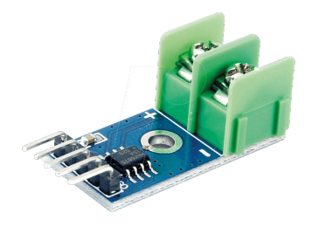
Feedback system
Notes:
Feedback system has main objective is to obtain, and transfer measured output value in order to be compared to setpoint value. In the case of temperature controller as used in this project, special kind of thermometer has to be used.
Type K Thermocouple provides widest operating temperature range. It consist of positive leg which is non-magnetic and negative leg which is magnetic.
The MAX6675 5.3 performs cold-junction compensation and digitizes the signal from a type-K thermocouple.

Slide 11
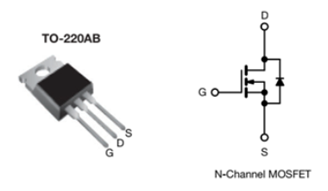
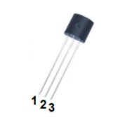
Control
- Arduino
- MOSFET
- S8050
Notes:
As a controller, Arduino was used. Arduino is a single-board microcontroller. Besides the physical part of PID controller there is also a program made in Arduino IDE.
MOSFET = Transistor
In our project MOSFET was used for PWM [16] (pulse-width modulation). PWM is a method of reducing the average power delivered by an electrical signal, by effectively chopping it up into discrete parts, in other word, MOSFET will control the voltage that goes to heating element.
In this the project it is used as BJT to activate the N channel gate, so the MOSFET is activated with a LOW value in this case.

Slide 12
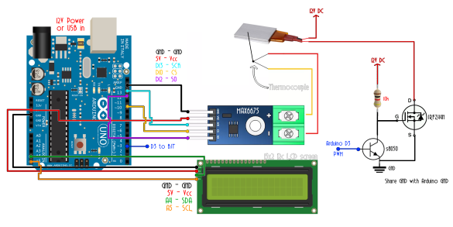
Final schematic

Slide 13
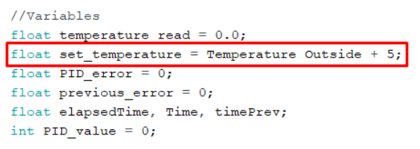
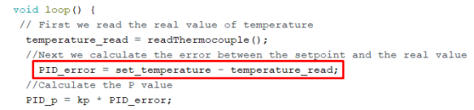
Arduino code
Notes:
Code starts with standard routines in Arduino code, such as including libraries and deciding pin connections. Following, variables are given initial values, inside this, most important value is given, named ‘set-temperature’
Furthermore, in beginning it is possible to find initial Kp, Ki and Kd values, which are calculated in the ‘Control Design, Analysis and Simulation’ section. Main loop of the code starts with reading the temperature of 23 room. Subsequently, error is calculated as “Error = Setpoint Temperature – Measured Temperature”. Next, P, I and D values are calculated with multiplication of the error with PID constants from the beginning.
Finally, PWM modulation is conducted by writing PWM signal to the MOSFET on digital pin D3

Slide 14
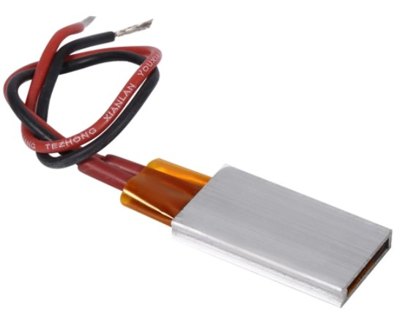
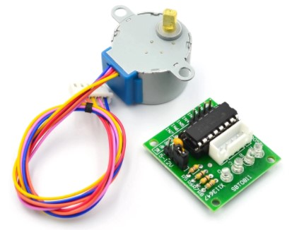
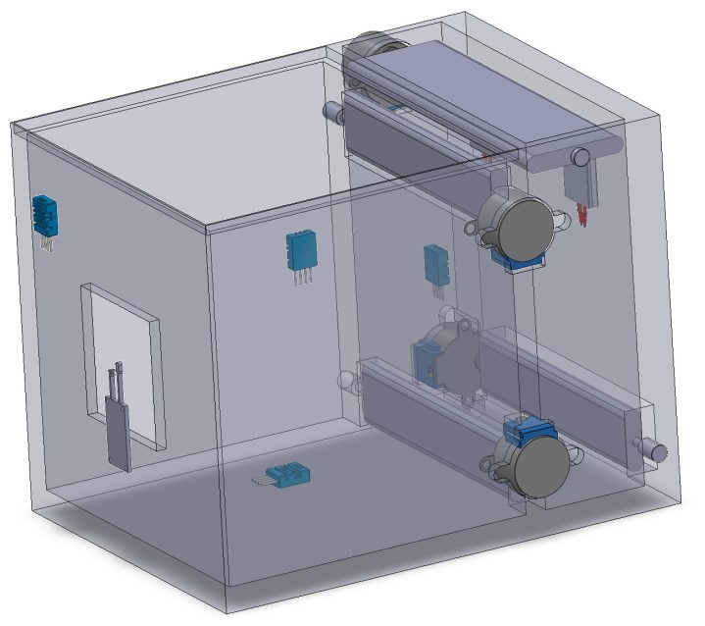
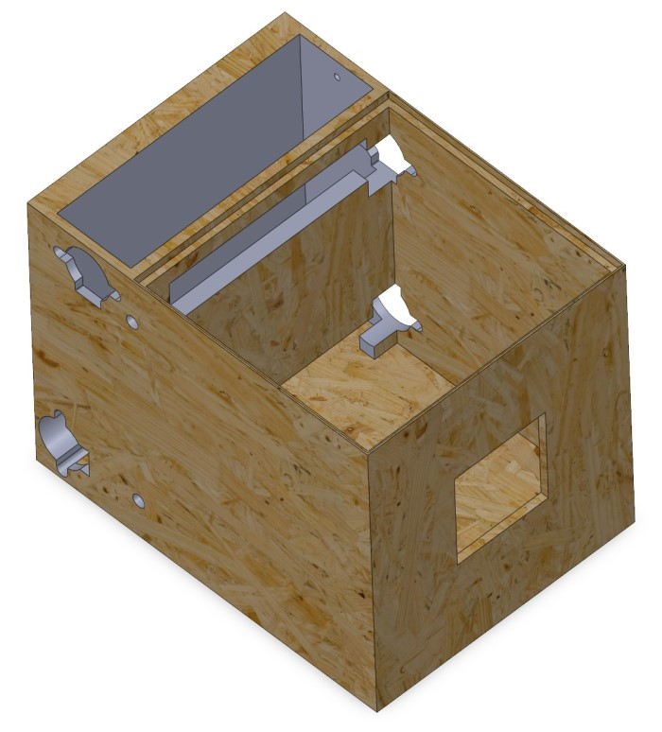
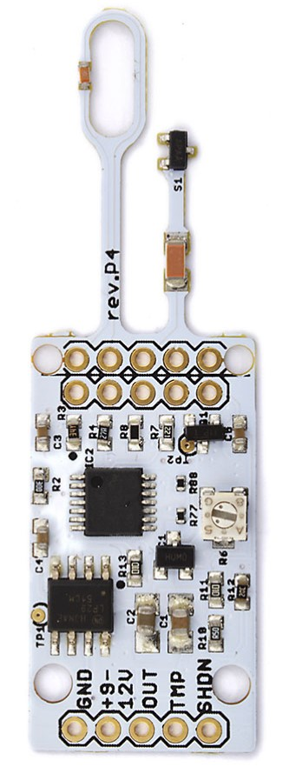
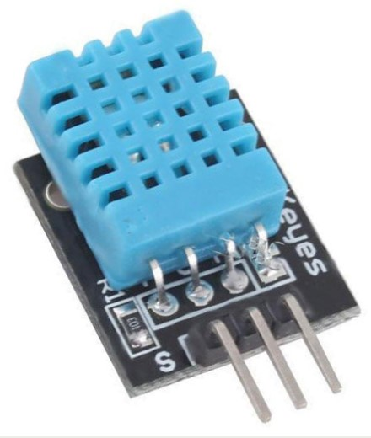
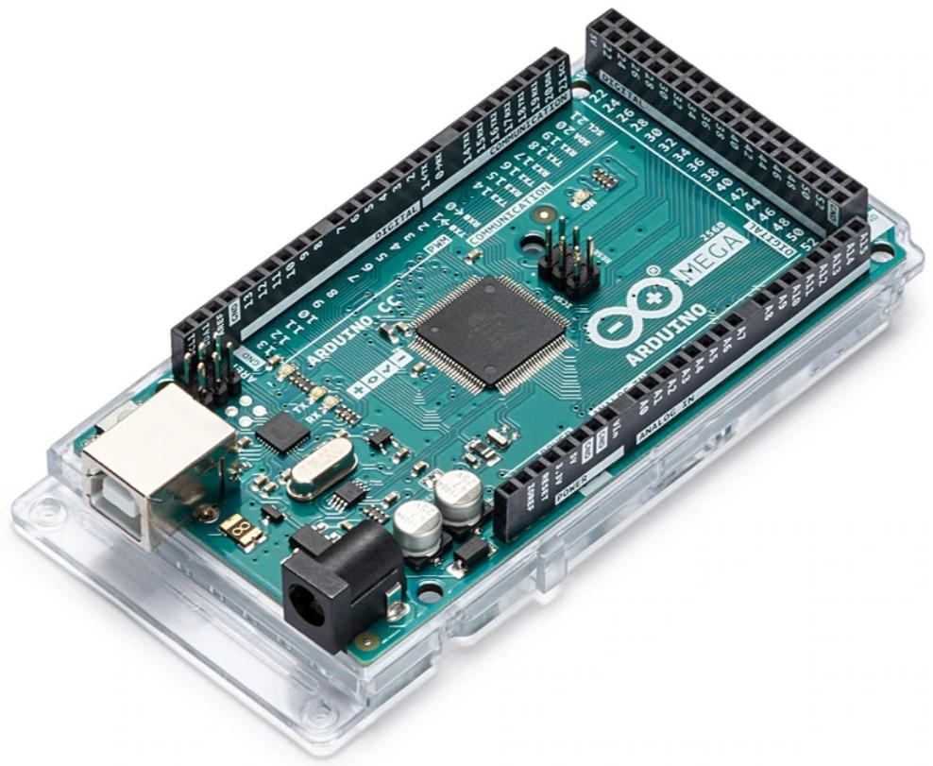
Experimental Setup
Model of a house with a solar chimney that could prove the theoretical operation of a solar house

Slide 15
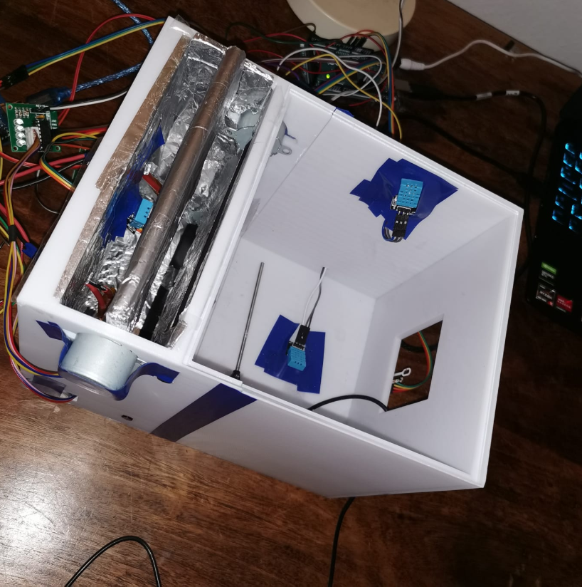
Experimental Setup
Due to limitations and according to the theoretical model that would support the process of heating and cooling, experimental model was realized on a 3D printer in a scaled version

Slide 16
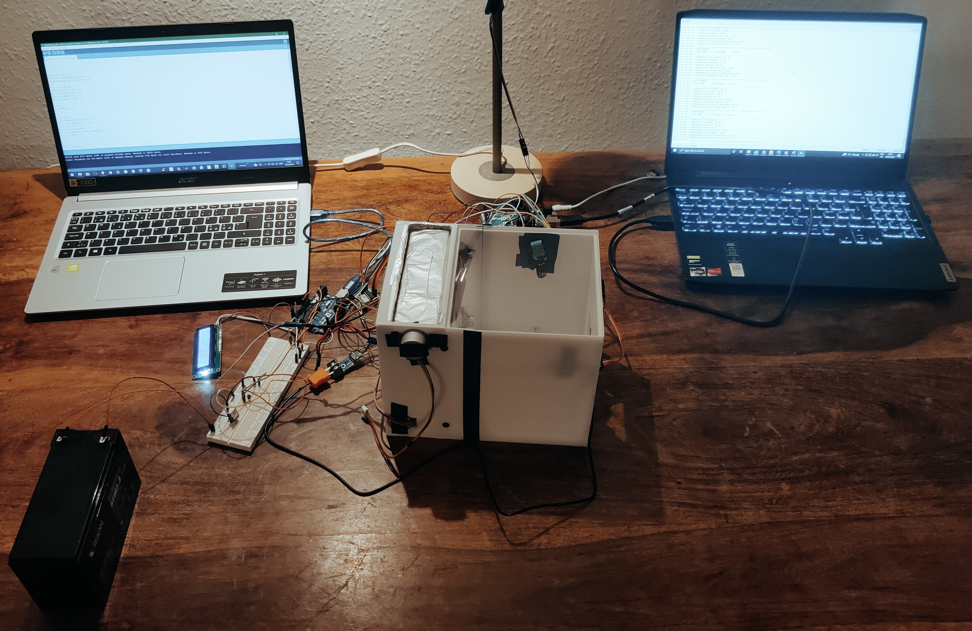
Experimental Setup
The complete assembly of Solar House model with Controller Setup

Slide 17
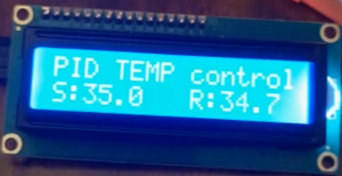
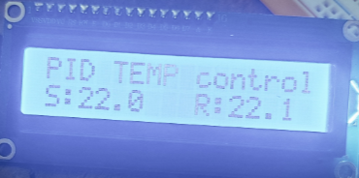
Conclusion
- Problem formulation goals
- Future improvements
- All in all...

Slide 18

Thank you for Your attention!

